Slide 1
Just for FUN
draft

Slide 2
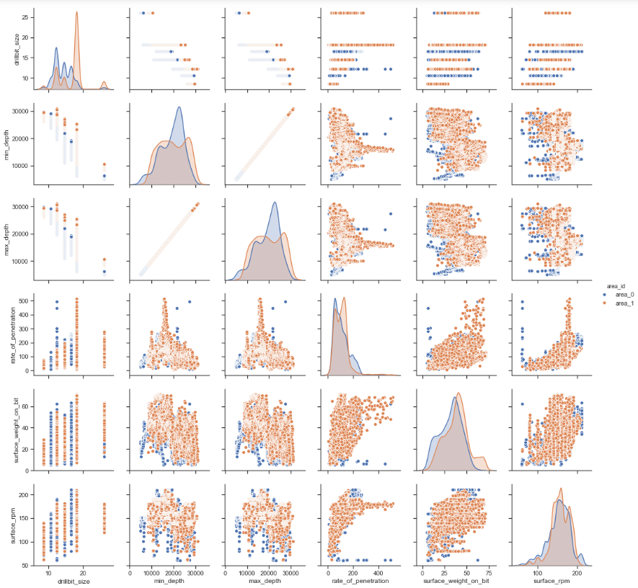

Slide 3
Feature Variable Importance
Variable: surface_rpm Importance: 0.45
Variable: surface_weight_on_bit Importance: 0.16
Variable: min_depth Importance: 0.09
Variable: max_depth Importance: 0.09
Variable: bit_model_id_bit_model_20 Importance: 0.06
Variable: drillbit_size Importance: 0.04
Variable: bit_model_id_bit_model_17 Importance: 0.04
Variable: bit_model_id_bit_model_11 Importance: 0.01
Variable: area_id_area_0 Importance: 0.0
Variable: area_id_area_1 Importance: 0.0

Slide 4
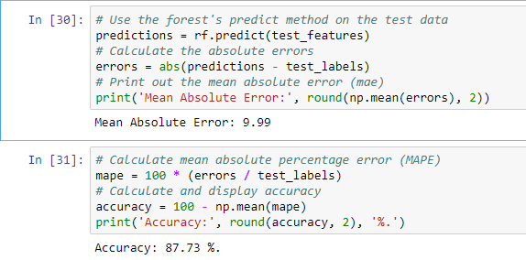
Model Accuracy

Slide 5
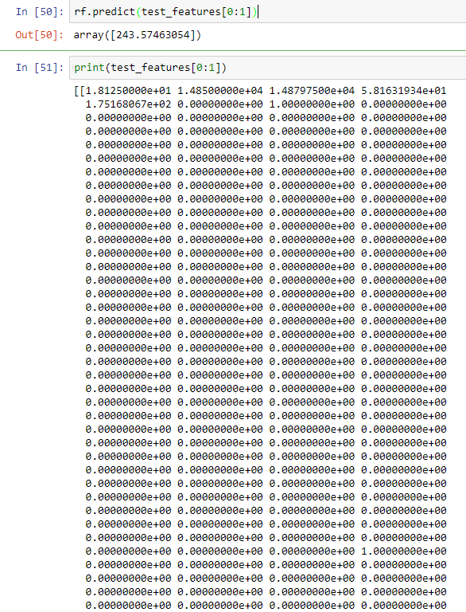
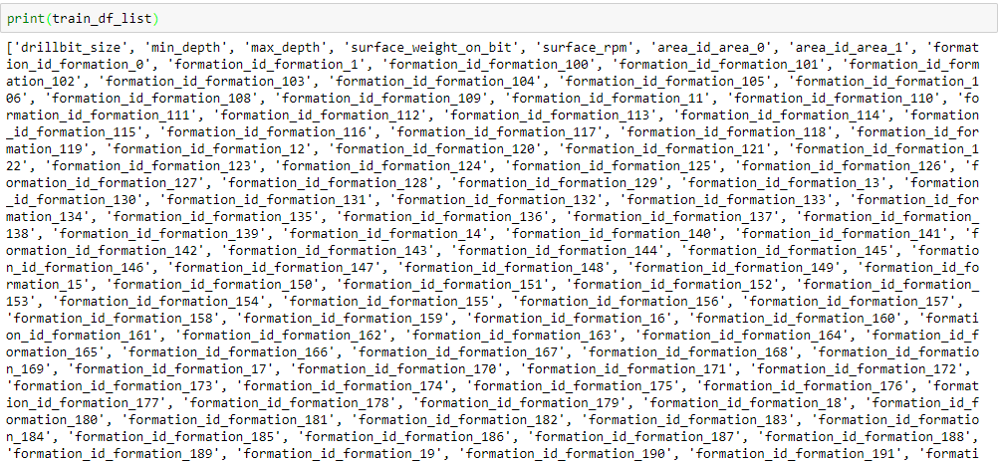
Sample Prediction
ROP

Slide 6
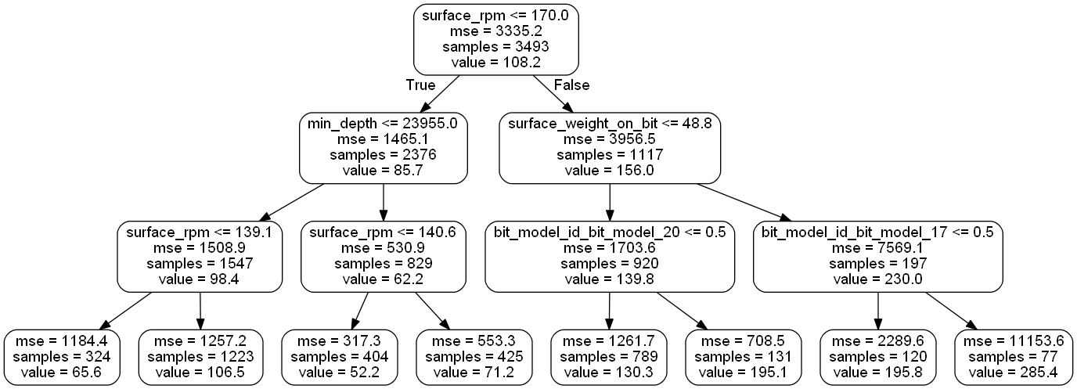
Sample small Tree

